Slide 1
GEOG0114: Principles of spatial analysis
WEEK 10: spatial models (part 2)
Dr Anwar Musah (a.musah@ucl.ac.uk)
Lecturer in Social and Geographic Data Science
UCL Geography
1

Slide 2
Contents
Introduction to Geographically Weighted Regression Modelling
Extending the standard linear regression to GWR
Using GWRs to estimate the local (not global) relationships between a dependent and independent variable
Determination of whether local relationships are statistically significant or not
Model performance through Local R-squared
Methodology for statistical analysis and interpretation
Overarching summary of the GEOG0114
Problem
Knowledge
Collect
Model
Wrangle
Explore
2

Slide 3
Recap
Spatial Models
Week 9
Week 10
Spatial Lag and Error Models
Geographically Weighted Regression (GWR) Models
In Week 9, we learnt special types of spatial model which accounts for spatial configuration of areal data
3

Slide 4
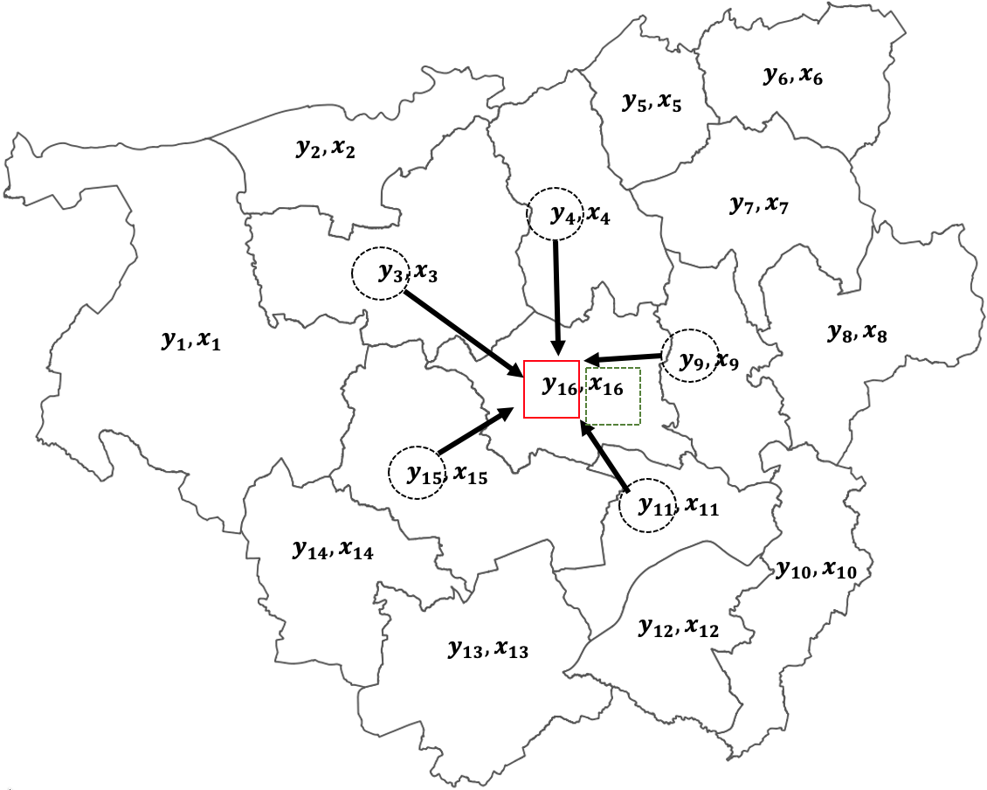
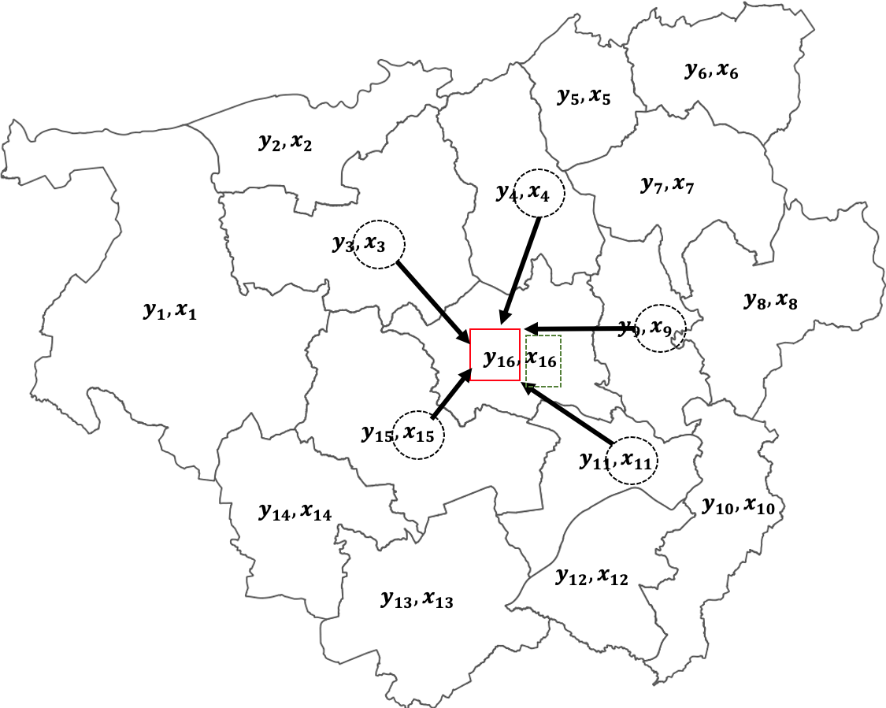
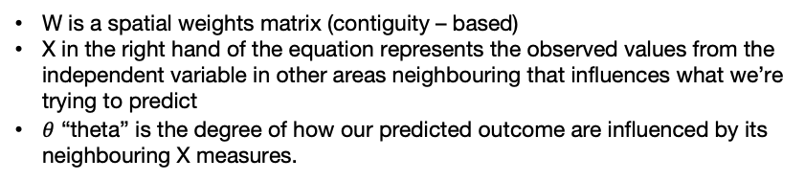
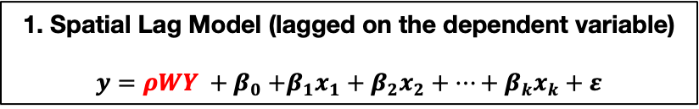
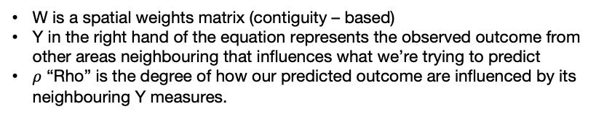

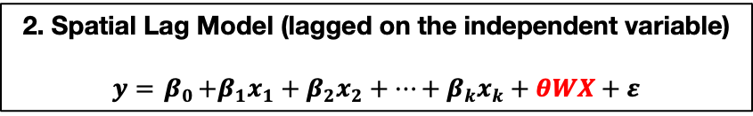
Recap
Multivariable Linear Regression
$$y= β_{0}+β_{1}x_{1}+β_{2}x_{2}+…+β_{k}x_{k}+ε$$
1. Spatial Lag Model (lagged on the dependent variable)
$$y=ρWY {+ β}_{0}+β_{1}x_{1}+β_{2}x_{2}+…+β_{k}x_{k}+ε$$
2. Spatial Lag Model (lagged on the independent variable)
$$y={ β}_{0}+β_{1}x_{1}+β_{2}x_{2}+…+β_{k}x_{k}+θWX+ε$$
Scenario 1
Scenario 2
W is a spatial weights matrix (contiguity – based)
Y in the right hand of the equation represents the observed outcome from other areas neighbouring that influences what we’re trying to predict
$ρ$ “Rho” is the degree of how our predicted outcome are influenced by its neighbouring Y measures.
W is a spatial weights matrix (contiguity – based)
X in the right hand of the equation represents the observed values from the independent variable in other areas neighbouring that influences what we’re trying to predict
$θ$ “theta” is the degree of how our predicted outcome are influenced by its neighbouring X measures.
4

Slide 5
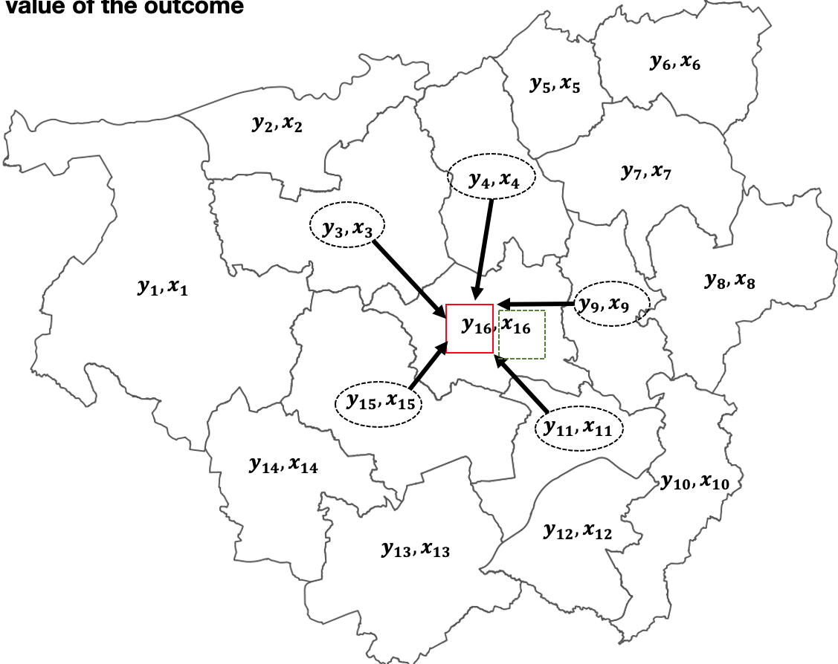
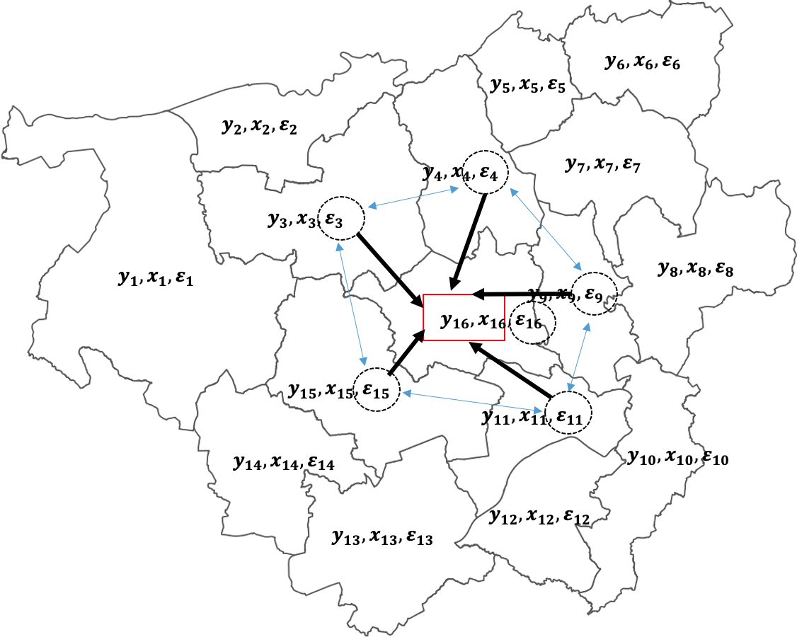
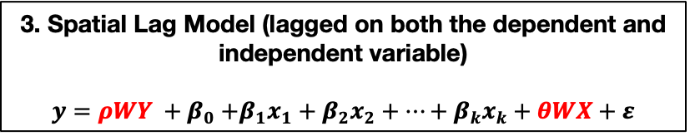
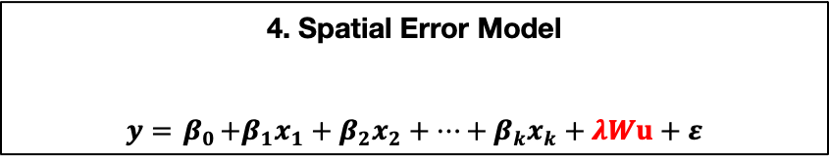
Recap
Multivariable Linear Regression
$$y= β_{0}+β_{1}x_{1}+β_{2}x_{2}+…+β_{k}x_{k}+ε$$
3. Spatial Lag Model (lagged on both the dependent and independent variable)
$$y=ρWY {+ β}_{0}+β_{1}x_{1}+β_{2}x_{2}+…+β_{k}x_{k}+θWX+ε$$
4. Spatial Error Model
$$y={ β}_{0}+β_{1}x_{1}+β_{2}x_{2}+…+β_{k}x_{k}+λWu+ε$$
Scenario 3
Scenario 4
Refer to slide number 3 to see the meanings of each parameters
u are the correlated spatial error terms
$λ$ “lambda” estimated coefficient for the product W and u.
5

Slide 6
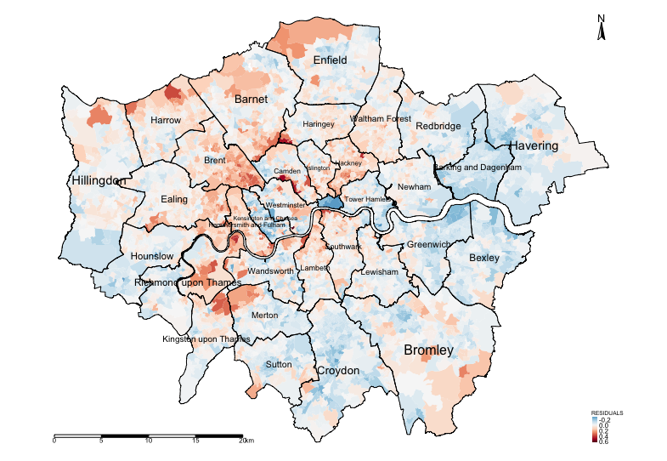
Recap
Modelled results from Linear and Spatial Lag (Y) regression model
Variable(s) | Linear Model | Lag (Y) Model (Total effects)
log(Income) | 2.036* | 2.217*
log(Deprivation) | 0.136* | 0.079*
log(PTAL) | 0.031* | 0.019*
AIC | -8510.8 | -9863.3
R² | 0.7889 (78.89%) | N/A
While we have accounted for spatial configuration using the spatial model, as well as accounted for spatial autocorrelation, we were able to determine the Global relationships between dependent and independent variables.
What about if we want to investigate further patterns but a much local-level?
LM, and any of the spatial Lag and error models cannot solve this problem
Examining the residuals for determining spatial patterning and evidence of spatial autocorrelation. Moran’s I test was 0.475 (p < 0.001) meaning that the residuals are clustered.
Broadly, there’s an over-estimation in the house-price and spatial aspects needs to be accounted for.
6

Slide 7
Spatial Models
Week 9
Week 10
Spatial Lag and Error Models
Geographically Weighted Regression (GWR) Models
7

Slide 8
What is a Geographically Weighted Regression
8

Slide 9
Definition of Geographically Weighted Regression (GWR) model:
GWR is a statistical model which can indicate where non-stationarity may take place across space; it can be used to identify how locally weighted regression coefficients may vary across the study area (unlike its counterpart i.e., the Spatial Lagged and/or Error Models which provides global coefficients)
We use GWRs to:
Determine area-specific relationships or local associations between a specified outcome (i.e., dependent variable) with one or more predictors (i.e., independent variable(s))
Find out whether those area-specific relationship or local associations are statistically significant across geographic space.
9

Slide 10
GWRs fall under the family of linear regression models. Recall last week the various model types and families?
Here is a board overview:
Distribution of dependent variable | Suitable Model
Continuous measures: e.g., average income in postcode (£); concentrations of ambient particular matter (PM2.5); Normalised Vegetative Difference Index (NDVI) etc., | Linear regression
Binary measures (1 = “present” or 0 = “absent”): e.g., Person’s voting for a candidate, Lung cancer risk, house infested with rodents etc., | Logistic Regression
Binomial measure (or proportion): e.g., prevalence of houses in a postcode infested with rodents, percentage of people in a village infected with intestinal parasitic worms, prevalence of household on a street segment victimised by crime etc., | Logistic Regression
Counts or discrete measures: e.g., number of reported burglaries on a street segment, number of riots in a county etc., | Poisson Regression
Time-to-event binary measures: e.g., Lung cancer risk due to chronic exposure to environmental levels of indoor radon. Risk of landslide and time dependence of surface erosion etc., | Survival Analysis with Cox regression
10

Slide 11
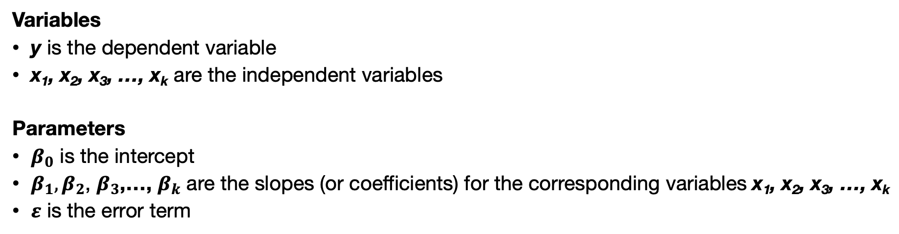
Multivariable Linear Regression Model
$$y= β_{0}+β_{1}x_{1}+β_{2}x_{2}+…+ε$$
Variables
y is the dependent variable
x₁, x₂, x₃, …, x_{k} are the independent variables
Parameters
$β_{0}$ is the intercept
$β_{1},β_{2}$, $β_{3}$,…, $β_{k}$ are the slopes (or coefficients) for the corresponding variables x₁, x₂, x₃, …, x_{k}
$ε$ is the error term
11

Slide 12
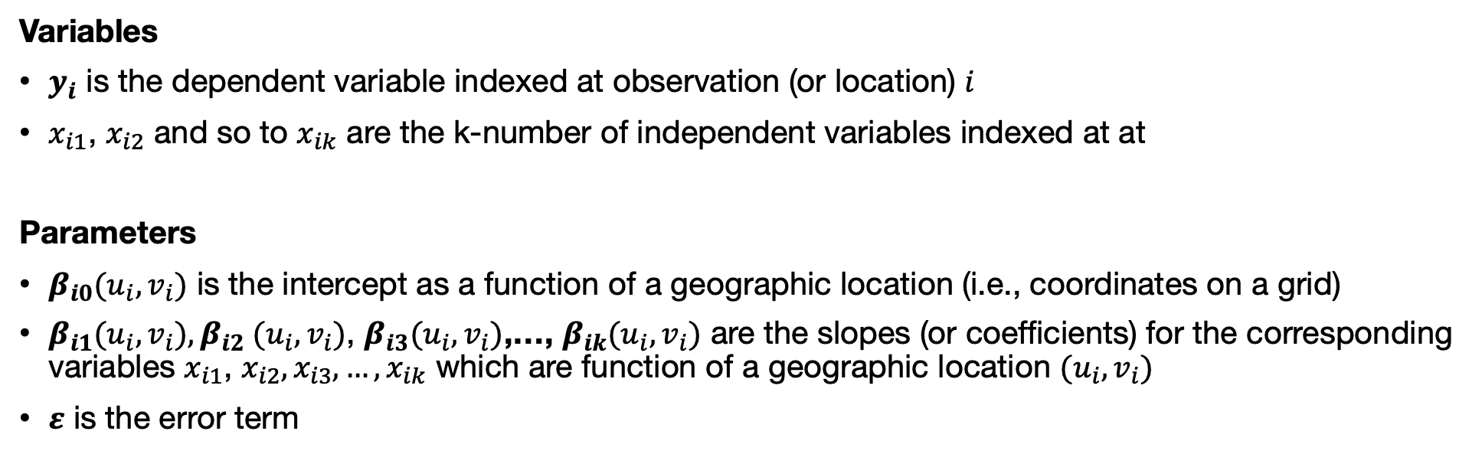
Geographical Weighted Regression Model
Variables
$y_{i}$ is the dependent variable indexed at observation (or location) $i$
$x_{i1}$, $x_{i2}$ and so to $x_{ik}$ are the k-number of independent variables indexed at at
Parameters
$β_{i0}(u_{i},v_{i})$ is the intercept as a function of a geographic location (i.e., coordinates on a grid)
$β_{i1}(u_{i},v_{i}),β_{i2}$ $(u_{i},v_{i})$, $β_{i3}(u_{i},v_{i})$,…, $β_{ik}(u_{i},v_{i})$ are the slopes (or coefficients) for the corresponding variables $x_{i1}$, $x_{i2},x_{i3}{, …, x}_{ik}$ which are function of a geographic location $(u_{i},v_{i})$
$ε$ is the error term
$$y_{i}= β_{i,0}(u_{i},v_{i})+β_{i,1}(u_{i},v_{i})x_{i,1}+β_{i,2}(u_{i},v_{i})x_{i,2}+…β_{i,k}(u_{i},v_{i})x_{i,k}+ε_{i}$$
12

Slide 13
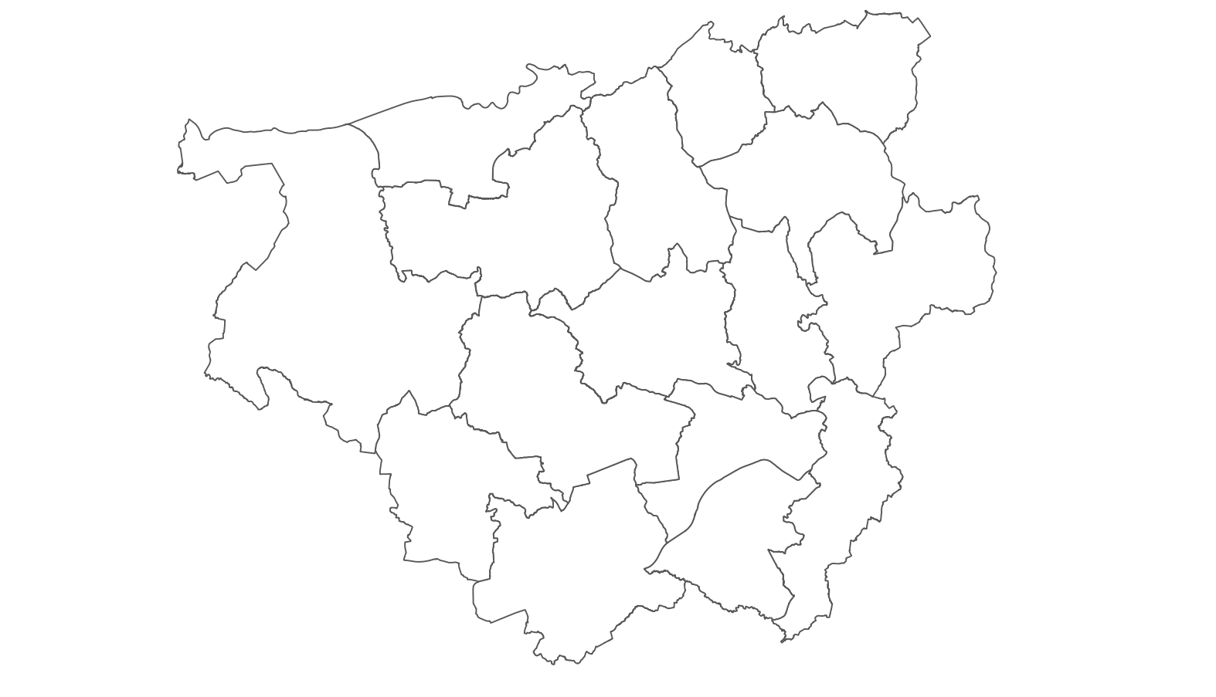
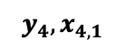
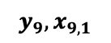
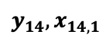
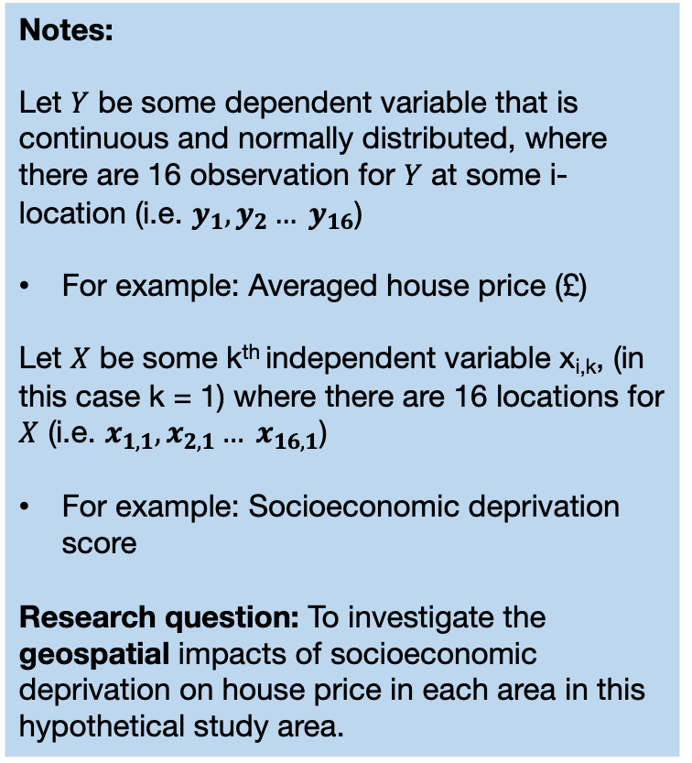
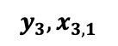
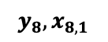
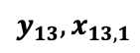
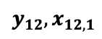
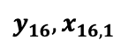
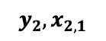
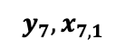
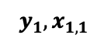
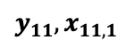
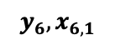
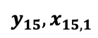
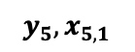
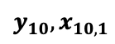
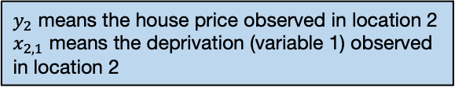
Suppose we have a hypothetical study area with 16 areas
Notes:
Let $Y$ be some dependent variable that is continuous and normally distributed, where there are 16 observation for $Y$ at some i-location (i.e. $y_{1},y_{2}… y_{16}$)
For example: Averaged house price (£)
Let $X$ be some k^{th} independent variable x_{i,k}, (in this case k = 1) where there are 16 locations for $X$ (i.e. $x_{1,1},x_{2,1}… x_{16,1}$)
For example: Socioeconomic deprivation score
Research question: To investigate the geospatial impacts of socioeconomic deprivation on house price in each area in this hypothetical study area.
$y_{2}$ means the house price observed in location 2
$x_{2,1}$ means the deprivation (variable 1) observed in location 2
$$y_{6},x_{6,1}$$
$$y_{5},x_{5,1}$$
$$y_{2},x_{2,1}$$
$$y_{4},x_{4,1}$$
$$y_{7},x_{7,1}$$
$$y_{3},x_{3,1}$$
$$y_{1},x_{1,1}$$
$$y_{8},x_{8,1}$$
$$y_{9},x_{9,1}$$
$$y_{16},x_{16,1}$$
$$y_{15},x_{15,1}$$
$$y_{11},x_{11,1}$$
$$y_{14},x_{14,1}$$
$$y_{10},x_{10,1}$$
$$y_{12},x_{12,1}$$
$$y_{13},x_{13,1}$$
Insufficient to use the typical linear regression model for this context
$$y= β_{0}+β_{1}x_{1}+ε$$
13

Slide 14
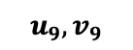
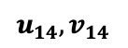
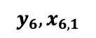
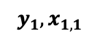
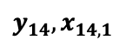
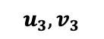
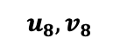
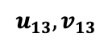
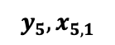
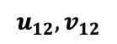
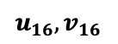
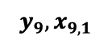
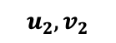
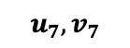
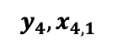
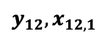
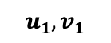
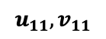














Suppose we have a hypothetical study area with 16 areas
Notes:
We want to model the relationship of $y_{i},x_{i,1}$ at location ($u_{i},v_{i}$)
Because $y_{i},x_{i,1}$ is calibrated on ($u_{i},v_{i}$) as a function, we are able to use some model (i.e., GWR) to compute coefficients at each location of $i$.
In this example for IMD, these coefficients are represented as $β_{i,1}(u_{i},v_{i})$
$$u_{6},v_{6}$$
$$u_{5},v_{5}$$
$$y_{6},x_{6,1}$$
$$u_{2},v_{2}$$
$$y_{5},x_{5,1}$$
$$y_{2},x_{2,1}$$
$$u_{4},v_{4}$$
$$u_{7},v_{7}$$
$$y_{4},x_{4,1}$$
$$y_{7},x_{7,1}$$
$$u_{3},v_{3}$$
$$y_{3},x_{3,1}$$
$$u_{1},v_{1}$$
$$u_{8},v_{8}$$
$$y_{1},x_{1,1}$$
$$u_{9},v_{9}$$
$$y_{8},x_{8,1}$$
$$u_{16},v_{16}$$
$$y_{9},x_{9,1}$$
$$y_{16},x_{16,1}$$
$$u_{15},v_{15}$$
The GWRs implicitly use distance-based weights through spatial kernels or bandwidths. Hence, it relies on points.
Centroids are extracted from areas and used for such analysis.
$$y_{15},x_{15,1}$$
$$u_{11},v_{11}$$
$$y_{11},x_{11,1}$$
$$u_{14},v_{14}$$
$$y_{14},x_{14,1}$$
$$u_{10},v_{10}$$
$$y_{10},x_{10,1}$$
$$u_{12},v_{12}$$
$$u_{13},v_{13}$$
$$y_{12},x_{12,1}$$
$$y_{13},x_{13,1}$$
$$y_{i}= β_{i,0}(u_{i},v_{i})+β_{i,1}(u_{i},v_{i})x_{i,1}+ε_{i}$$
14

Slide 15























































































GWR with fixed spatial kernel (or bandwidth)
Note: GWRs are distance-based models. It uses bandwidth to consider nearest neighbours when accounting spatial configuration.
15

Slide 16













































































GWR with adaptive spatial kernel (or bandwidth)
Use the Adaptive spatial kernel for building your spatial weights! It is much better than using the fixed bandwidth
16

Slide 17
The Beginning: Introduction to Spatial Analysis and Data Science
Workflow for GWR modelling
17

Slide 18
Modelling process using GWR
When you want to conduct evidence-based analysis with spatial data – especially if the outcome is from a continuous distribution – you might want to follow these steps:
STEP 1: Carry some descriptive analysis to understand the underlying spatial distribution
STEP 2: Perform a Linear regression in order to assess the residuals for the model output to determine whether not the assumptions of independence have been violated.
You can check for multicollinearity among independent variable using the Variance Inflation Factor (VIF < 10)
If there’s a violation:
STEP 3: Examine whether there is evidence of spatial dependence in the residuals using Moran’s I test.
If Moran’s I test is not significant – STOP! NO EVIDENCE OF SPATIAL DEPENDENCE HENCE NO NEED OF SPATIAL APPROACH
If Moran’s I test is significant and positive – then map the residuals accordingly to examine the spatial patterning of the residual.
STEP 4: Extract the centroids of the areas and use them for computing the kernel bandwidths. [I] Highly recommend to use the adaptive bandwidths, which is flexible than the fixed for estimating the optimal bandwidth.
STEP 5: The estimated bandwidth is fitted into the GWR model to estimate the following quantities: 1.) Local R-squared, 2.) area-specific coefficients and 3.) standard errors for significance test for each areas.
STEP 6: Extract the coefficients and desired results and map them accordingly to examine the spatial variation in the relationship between dependent and independent variables.
STEP 7: Interpretation
18

Slide 19
Example using the house price data for London
Reporting the Global estimates
Modelled results in table are from Linear, Spatial Lag (Y) and GWR regression model
Variable(s) | Linear | Lag (Y) | GWR
log(Income) | 2.036* | 1.267* | 2.036
log(Deprivation) | 0.136* | 0.045* | 0.137
log(PTAL) | 0.031* | 0.011* | 0.030
AIC | -8510.8 | -9863.3 | -11242
R² | 0.7889 (78.89%) | N/A | 0.9318 (93.18%)
The GWR model is better than the linear and Spatial Lag regression. We take the model with the highest R-squared value, as well as the lowest AIC value.
Examining the residuals for determining spatial patterning and evidence of spatial autocorrelation. Moran’s I test was 0.475 (p < 0.001) meaning that the residuals are clustered.
Broadly, there’s an over-estimation in the house-price and spatial aspects needs to be accounted for.
19

Slide 20


Reporting the local estimates (using socioeconomic deprivation (adjusted for other risk factors) as an motivating example)
Interpretation: There is spatial variability in the relationship between our variable socioeconomic deprivation (transformed) and averaged house price (transformed) in London. The GWR outputs reveals that local coefficients range from a minimum value of -0.946 to a maximum value of 1.085, indicating that one percentage point increase in the levels of deprivation in LSOAs of London is associated with a reduction of 0.946% in house prices in some LSOAs and (weirdly) an increase of 1.085% in others. Broadly, the relationship are opposing.
Interpretation: For instance, in the Borough of Hounslow, we can see a significant reduction in house prices in relation to increased levels of socioeconomic deprivation (adjusted for income and accessibility). Such reduction are clustered in the mid-section of Borough of Hounslow which were coloured red. Note that in far north eastern section of the Borough of Hounslow with pockets of LSOA's coloured blue shows a significant increase in house price in relationship to IMD which is difficult to explain and thus can be interpreted as a chance finding. All sections that are coloured white are not significant.
20

Slide 21

Reporting the local R-squared to assess the model's performance for each areas
Interpretation: The areas that are going towards the shade of dark reds (i.e., value of 0) are local regression models that have broadly performed poorly in its prediction for house price and its association with the three variables (income, deprivation and PTAL). Likewise, the areas that are going towards the shade of dark blues (i.e., value of 1) are local regression models that have broadly performed very well in its prediction for house price and its association with the three variables (income, deprivation and PTAL).
Note: These results are essential as the local R2 values of each area show the model’s ability to predict the explained variance in house prices caused by deprivation, income and accessibility for specific areas.
21

Slide 22
Any questions about GWR?
22

Slide 23
The Beginning: Introduction to Spatial Analysis and Data Science
Summary of GEOG0114 & Assessment
23

Slide 24
What have we covered in the last 10 weeks…
Week | Weekly Topics
1 | Spatial Analysis for Data Science
2 | Graphical Representation of Spatial Data
3 | Spatial Autocorrelation
4 | Suitability Mapping: Part I (Qualitative approach)
5 | Suitability Mapping: Part II (Quantitative approach)
Reading Week (Assessment)
6 | Geostatistics using Kriging
7 | Geodemographics
8 | Transport Network Analysis
9 | Spatial Models: Part I (Spatial Lag & Error Models)
10 | Spatial Models: Part II (Geographically Weighted Regression)
24

Slide 25
Tips/Strategy for the Assignment
25
Overarching descriptive analysis of the raster or area dataset
Basic summary measures
Spatial distribution and patterning
Description about the dataset
Areal data
Raster-based analysis
What process does the point data follow?
Moran’s I test
LISA test
Geostatistical
Point Process
To make LISA interesting – we suggest exploring multiple outcomes to examine co-occurrence of clusters
Regression-Based Models
Ordinary/Regression Kriging
Ecological Niche Model
Linear Regression Models
Standalones
Unique aggregated data for street segments?
Rasters only, and you have no
point data?
You have several independent variables at an areal level e.g., demographic, socioeconomic, and other lifestyles – you want to generate a salient category?
Spatial Lag and Error Models
Transport Network Analysis
Analytical Hierarchical Process
Geodemographic Classification
Geographically Weighted Regression
25

Slide 26
Example Data source(s)
UK Datasets
UK Census 2021: https://www.nomisweb.co.uk/sources/census_2021_bulk
UK Deprivation (2010, 2015) and 2019: https://www.gov.uk/government/statistics/english-indices-of-deprivation-2019
UK population 2010-2022 mid-year estimates: [LINK]
Police: https://data.police.uk/
CDRC: https://data.cdrc.ac.uk
London Data Store: https://data.london.gov.uk
Mosquito/species data
Global Biodiversity Information Facility: https://www.gbif.org
Global Mosquito Observatory Database (GMOD): https://experience.arcgis.com/experience/7228a5a27442468494caec2934c2b73d/page/Page/
Malaria Atlas Project: https://malariaatlas.org
Disaster-related fire datasets
Fire Information for Resource Management System: https://firms.modaps.eosdis.nasa.gov
[1] Several domestic fire outcomes (LSOA) in UK: https://assets.publishing.service.gov.uk/media/64be67369c2df000129402cf/low-level-geography-dataset-270723.ods
[2] Guidance note for [1]: https://www.gov.uk/government/statistics/fire-statistics-incident-level-datasets/low-level-geography-dataset-guidance
Disaster dataset
EM-DAT International Disaster Database: [LINK]
Humanitarian dataset
Humanitarian Data Exchange: https://data.humdata.org
Worldpop HUB: https://www.worldpop.org
Global Terrorism Database: https://www.start.umd.edu/gtd/
Armed Conflict Location and Event Data: https://acleddata.com
WHO-ESPEN Project containing tropical diseases in Sub-Saharan Africa:
https://espen.afro.who.int/ | https://espen.afro.who.int/tools-resources/cartography-database | https://espen.afro.who.int/tools-resources/download-data
Inspiration for writing methodology
Musah et al. (2020): https://doi.org/10.1016/j.apgeog.2019.102126
Todd et al. (2022): https://doi.org/10.1177/23998083211001836
Li et al. (2022): https://doi.org/10.1016/j.apgeog.2022.102718
26

Slide 27


Go to Moodle’s Assessment
Assignment Documentation: Guidance notes and Cover Sheet
See Best examples of past projects from 2021/22 and 2022/23
PLEASE GO THROUGH THE DOCUMENTATION!
Spatial Data Analysis Project
Assignment’s deadline is Monday 13th January 2024 (by 12:00pm)
27

Slide 28

28

Slide 29


The ‘Dos’ and ‘Dont’s’
Make sure that your figures and tables are publication-worthy [1]
If you produce an image like this – it’s an automatic failure
29

Slide 30


The ‘Dos’ and ‘Dont’s’
Make sure that your figures and tables are publication-worthy [2]
Best Standards:
Fully formatted table, with table legends which looks great, and it is of the standards that is considered publication-worthy. This type will yield you full marks i.e., correct results and show an eye details.
Table 2: Shows a descriptive analysis of the lung capacity function (i.e., volume) stratified by gender. Data is from among 654 respondents from the East Midlands.
Normal Standards:
Partially formatted table, with no table legends which looks rudimentary. No way near considered publication-worthy (i.e., in a report, research article, thesis etc.). The marker will be like “meh”… but if s/he (i.e., marker) is pissed-off or woke up on the wrong side of the bed, they may deduct marks.
30

Slide 31
The ‘Dos’ and ‘Dont’s’
Make sure that your figures and tables are publication-worthy [3]
# A tibble: 2 × 9
gender n mean sd median q1 q3 min max
<chr> <int> <dbl> <dbl> <dbl> <dbl> <dbl> <dbl> <dbl>
1 female 318 5.35 1.94 5.46 3.85 6.98 0.373 9.51
2 male 336 6.44 3.01 5.82 4.03 8.60 0.388 15.4
# A tibble: 3 × 9
agegroup n mean sd median q1 q3 min max
<chr> <int> <dbl> <dbl> <dbl> <dbl> <dbl> <dbl> <dbl>
1 <55 years 130 3.07 1.04 3.06 2.42 3.63 0.373 5.73
2 55-59 years 407 5.99 1.98 5.76 4.57 7.15 1.88 13.7
3 60+ years 117 8.80 2.39 8.56 7.17 10.7 4.59 15.4
# A tibble: 2 × 9
altitude n mean sd median q1 q3 min max
<chr> <int> <dbl> <dbl> <dbl> <dbl> <dbl> <dbl> <dbl>
1 high land 65 7.83 2.25 7.51 6.38 9.25 3.08 12.6
2 low land 589 5.70 2.55 5.40 3.76 7.14 0.373 15.4
Crap standards:
Not even worth the marker’s time.
If you want to alienate the markers, we dare you to submit an assignment with tables not formatted…
We double dare you to submit an output that is copied and pasted from R…
31

Slide 32

The ‘Dos’ and ‘Dont’s’
Make sure that your figures and tables are publication-worthy [4]
Really crap standards:
Even worse… we triple dare you to take a screenshot and paste it into your assignment…
32

Slide 33

“We will shut that sh*t down! No exceptions”
[Quote: Negan (The Walking Dead, Season 6, Episode 16 [Last Day on Earth])
33

Slide 34

The ‘Dos’ and ‘Dont’s’
Readability of outputs and formatting of pages [1]
If you have multiple figure outputs, you are welcome to generate a panelled figure that is annotated alphabetically.
The issue is that squeezing a panelled figure on portrait document reduces it readability severely.
You should pay close attention to even these little things to avoid alienating your marker.
A
B
C
D
For the marker to make sense of this image, s/he
will be forced to zoom in the +400% any to still see
blurry figure…
34

Slide 35

The ‘Dos’ and ‘Dont’s’
Show the image in its glory to the fullest by taking advantage of the landscape settings
Readability of outputs and formatting of pages [2]
This is a crude example to illustrate what I mean about showing your results nicely to its fullest glory.
Notice the page number has been formatted accordingly to the width of the page, instead of it being on the length to ensure consistency in the page number position if the document was printed.
Markers appreciate this level of detail and are not above being sympathetic in awarding extra marks for quality in presentation.
35
Notes:
Flexibility with page numbers

Slide 36

The ‘Dos’ and ‘Dont’s’
Avoid violating the core assumptions behind these analytical techniques
Any violation of the core assumptions – whether it be data-related, or distributional will be considered as a critical error.
Marks will be deducted accordingly. It should be noted that your marks are capped at 68/69.
If it’s horrible violation, to such extent its irredeemable, then in such scenario can potentially lead to a failing grade.
36

Slide 37

The ‘Dos’ and ‘Dont’s’
Use of Generative AI (e.g., ChatGPT) and References
If you're using GenAI to assist or troubleshoot with the R coding part of the assessment, that's perfectly fine. You just need to acknowledge the use of GenAI in your methodology section, especially if it was used for straightforward tasks like data cleaning or manipulation.
“I acknowledge the use of ChatGPT (https://chatgpt.com/) to improve my writing, and assistance with R coding”
However, if GenAI was used for more significant contributions, such as getting information to describe the statistical methodology or modelling approach, you must provide a proper citation. UCL offers guidelines on how to cite GenAI in such cases. For example, if I asked ChatGPT the following:
“How to generate Stan Code for a Bayesian ICAR spatial risk model?”
How to generate Stan Code for a Bayesian ICAR spatial risk model? (2024). ChatGPT (GPT-4o). Wednesday, 27 November. Available at: https://chatgpt.com/c/67471449-f31c-800c-a6e9-f22b554f7841
UCL Policy on referencing GenAI [LINK]
UCL Geography’s Policy on using GenAI in MSc assessments/Dissertations [LINK]
37

Slide 38
GEOG0114: Course Evaluation & Student Feedback (Week 7-10)
https://forms.gle/2bgUnHgY14vYzDsS9
Dear Students,
As part of the Continuous Module Dialogue, we are conducting this survey to gauge the levels of student satisfaction with the learning experience in module GEOG0114: Principles of Spatial Analysis. We would like to receive your feedback, which would be greatly appreciated. This will help us make improvements to the course. The survey should only take up to 5 or 10 minutes, and your responses are completely anonymous.
Thank you,
Anwar and Justin.
38

Slide 39

See you in term 2
39

